Slide 1
Timers

Slide 2
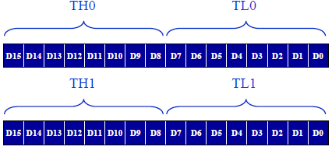
Timers
8051 has 2 Timers/Counters
- Timers to generate a time delay or as
- Event counters to count events happening outside the microcontroller
Both Timer 0 and Timer 1 are 16-bits wide.
Since 8051 has an 8-bit architecture, each 16-bits timer is accessed as two separate registers of low byte and high byte

Slide 3

Both timers 0 and 1 use the same register, called TMOD (timer mode), to set the various timer operation modes.
TMOD is a 8-bit register
The lower 4 bits are for Timer 0
The upper 4 bits are for Timer 1
In each case,
The lower 2 bits are used to set the timer mode
The upper 2 bits to specify the operation

Slide 4
M1 | M0 | Mode | Operating Mode
0 | 0 | 0 | 13-bit timer mode 8-bit timer/counter THx with TLx as 5-bit prescaler
0 | 1 | 1 | 16-bit timer mode 16-bit timer/counter THx and TLx are cascaded; there is no prescaler
1 | 0 | 2 | 8-bit auto reload 8-bit auto-reload timer/counter; THx holds a value which is to be reloaded TLx each time it overflows
1 | 1 | 3 | Split timer mode

Slide 5
Bit Details | High Value(1) | Low Value(0)
C/T | Configure for the Counter operations | Configure for the Timer operations

Slide 6
Solve
Indicate which mode and which timer are selected for each of the following.
1. TMOD = 00000001
2. TMOD = 00100000
3. TMOD = 00000000
4. TMOD = 00010000
What will TMOD be?
1. Mode 2 of timer 0 is selected
2. Mode 3 of timer 1 is selected

Slide 7
The timer’s clock frequency and its period for 8051-based system
8051 is designed to operate between 4MHz to 40MHz and generally operates with a crystal frequency 11.0592 MHz.
Since we know the crystal is pulsing 11,059,000 times per second and that one machine cycle is 12 pulses. we can calculate how many instructions cycles the 8051 can execute per second:
11,059,000 / 12 = 921,583
T = 1/921583 = 1.085 us

Slide 8

Operations of Mode1
It is a 16-bit timer; therefore, it allows a value of 0000 to FFFFH to be loaded into the timer’s register TL and TH.
After TH and TL are loaded with a 16-bit initial value, the timer must be started.
After the timer is started, it starts to count up until it reaches its limit of FFFFH.

Slide 9
When it rolls over from FFFFH to 0000, it sets high a flag bit called TF (timer flag)
– Each timer has its own timer flag: TF0 for timer 0 and TF1 for timer 1
When this timer flag is raised the timer should be stopped.
After the timer reaches its limit and rolls over, in order to repeat the process, TH and TL must be reloaded with the original value, and TF must be reloaded to 0.

Slide 10
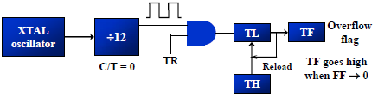
Operation of Mode 2
It is an 8-bit timer; therefore, it allows only values of 00 to FFH to be loaded into the timer’s register TH
After TH is loaded with the 8-bit value, the 8051 gives a copy of it to TL.
Then the timer is started.
After the timer starts, it starts to count up by incrementing the TL register. It counts up until it reaches its limit of FFH.
When it rolls over from FFH to 00, it sets the TF (timer flag) high.
When the TL register rolls from FFH to 0 and TF is set to 1, TL is reloaded automatically with the original value kept by the TH register
To repeat the process, we must simply clear TF

Slide 11
Operation of Mode 0
This mode configures timer 0 as a 13-bit timer, which consists of all 8 bits of TH0 and the lower 5 bits of TL0.
Each coming pulse causes the lower register bits to change their states. After receiving 32 pulses, this register is loaded and automatically cleared, while the higher byte (TH0) is incremented by 1.
This process is repeated until registers count up to 8192 pulses. After that, both registers are cleared, and counting starts from 0.

Slide 12
Operation of Mode 3
The 16-bit timer consisting of two registers, TH0 and TL0, is split into two independent 8-bit timers.
The TL0 timer turns into timer 0, while the TH0 timer turns into timer 1.
Even though the 16-bit Timer 1 can still be configured to operate in any of the modes (mode 1, 2 or 3), it is no longer possible to disable it as there is no control bit to do it. Thus, its operation is restricted when Timer 0 is in mode 3.

Slide 13
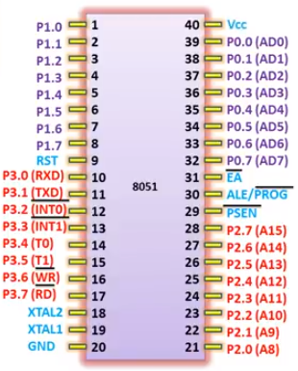
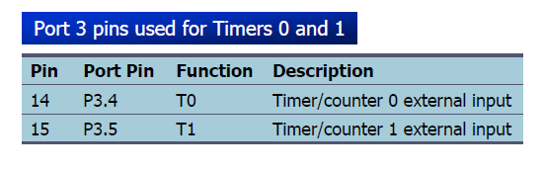
Counters
When C/T = 1, the timer is used as a counter and gets its pulses from outside the 8051
The counter counts up as pulses are fed from pins 14 and 15, these pins are called T0 (timer 0 input) and T1 (timer 1 input)

Slide 14

Timer Control (TCON) Register
TCON is an 8-bit control register and contains a timer and interrupt flags. Only 4 bits of this register are used for this purpose, while the rest is used for interrupt control.
TCON is used to control the operation of Timer 0 and Timer 1, as well as to monitor their status.

Slide 15
Bit 7 - TF1: Timer1 Overflow Flag
1 = Timer1 overflow occurred (i.e. Timer1 goes to its max and roll over back to zero).
0 = Timer1 overflow not occurred.
Bit 6 - TR1: Timer1 Run Control Bit
1 = Timer1 start.
0 = Timer1 stop.
Bit 5 – TF0: Timer0 Overflow Flag
1 = Timer0 overflow occurred (i.e. Timer0 goes to its max and roll over back to zero).
0 = Timer0 overflow not occurred.
Bit 4 – TR0: Timer0 Run Control Bit
1 = Timer0 start.
0 = Timer0 stop.

Slide 16
Gate in TMOD
Timers of 8051 can be started and stopped by either software or hardware control
If GATE=0
The start and stop of the timer are controlled by way of software by the TR (timer start) bits TR0 and TR1
If GATE = 1
The start and stop of the timer are done externally through pins P3.2 and P3.3 for timers 0 and 1, respectively

Slide 17
Generating a time delay
Load the TMOD value register indicating which timer (timer 0 or timer 1) is to be used and which timer mode (0 or 1) is selected.
Load registers TL and TH with an initial count value
Start the timer
Keep monitoring the timer flag (TF)
Get out of the loop when TF becomes high
Stop the timer
Clear the TF flag for the next round
Go back to Step 2 to load TH and TL again

Slide 18
Mode in TMOD Registers
Timer 0 Mode 0 | TMOD = 0x00
Timer 0 Mode 1 | TMOD = 0x01
Timer 0 Mode 2 | TMOD = 0x02
Timer 0 Mode 3 | TMOD = 0x03
Timer 1 Mode 0 | TMOD = 0x00
Timer 1 Mode 1 | TMOD = 0x10
Timer 1 Mode 2 | TMOD = 0x20
Timer 1 Mode 3 | TMOD = 0x30

Slide 19
Write an 8051 C program to toggle all the bits of port P1 continuously with some delay in between. Use Timer 0, 16-bit mode to generate the delay.
Solution:
#include <reg51.h>
void T0Delay(void);
void main(void){
while (1) {
P1=0x55;
T0Delay();
P1=0xAA;
T0Delay();
}
}
void T0Delay(){
TMOD=0x01;
TL0=0x00;
TH0=0x35;
TR0=1;
while (TF0==0);
TR0=0;
TF0=0;

